Slide 1
Handwritten Text to Digital Text Conversion
DISHA REDDY PEDDA BACHAGARI 700755814
Paper link : https://ieeexplore.ieee.org/document/9544513

Slide 2
INTRODUCTION
Handwritten Text Recognition (HTR), sometimes referred to as Handwriting Recognition (HWR), is the process by which a computer recognizes and understands handwritten text pictures.
The computer can be instructed to forecast and transform handwritten text into computerized or digital text from a variety of sources, including notebooks, documents, forms, photos, and other devices.

Slide 3
MOTIVATION
A large portion of this transition involves detecting transcripts from information inspection photos and turning them into high-level designs using manually written text recognition (HTR) or handwriting recognition (HWR). Notebooks, documents, forms, and photos are just a few of the devices that provide the input.
There are two kinds of recognition:
1.Offline Recognition: In this technique, the text from photographs is automatically converted to digital text. Data used in this technique is a static depiction of handwriting.
2. Online Recognition: In this case, the pen tip’s movements are detected using sensors. It consists of a writing pen, a touch screen that is integrated with output display, that converts input to digital output

Slide 4
OBJECTIVE
Develop a Robust HTR System: Build a deep learning model using CNN to accurately recognize and convert handwritten text from images into digital text.
Feature Extraction: Leverage CNN's ability to automatically extract important features from handwritten text images, such as shapes, strokes, and patterns, to enhance recognition accuracy.
Model Training: Train the CNN model on large datasets of handwritten text to learn the various handwriting styles and improve generalization.
Real-time Text Recognition: Implement a system capable of real-time or near-real-time recognition and conversion of handwritten content into machine-readable format.
Accuracy Improvement: Optimize the model to reduce errors and improve the precision of character and word recognition, using techniques like data augmentation, regularization, and fine-tuning.
Handle Variability: Ensure the model is robust enough to handle different handwriting styles, noise, and distortions in handwritten input.

Slide 5
RELATED WORK
The image processing, feature extraction, and classification methods employed in the development of each OCR system cause them to differ from one another.
For the purpose of reading alphanumeric characters, it is utilized as an input device for papers that have already been printed.
It is impossible for the current technologies to distinguish between a word and noise. A little dot that is actually noise is also recognized as a word.
Turkish OCR on mobile and scanned document images | Kurtulus Karasu, Muhammet Bastan (2015)
A proposed approach for character recognition using Document Analysis with OCR | Harneet Singh, Anmol Sachan (2018)
Classification of Documents Extracted from Images with Optical Character Recognition Methods | Omer Aydin (2021)

Slide 6
PROBLEM STATEMENT
Understand and be conversant with ideas such as support vector machines and decision trees in order to apply algorithms to real-world issues. Additional observations are made based on the reviewed studies.
Worked on different algorithms, to get better accuracy.
Comparing the accuracies and plotting graphically.

Slide 7
PROPOSED SOLUTION
CRNN (Convolutional Recurrent Neural Network): Combines CNNs and Recurrent Neural Networks (RNNs) to handle sequential dependencies in handwriting.
ResNet: A deep residual network used for image recognition tasks, including HTR, offering improved accuracy with very deep networks.
CTC-based models (Connectionist Temporal Classification): Used in HTR where alignment between input images and output sequences is not fixed, often combined with CNN and RNN for sequential learning.
These models are commonly trained on large handwritten datasets like IAM or MNIST to achieve high accuracy in recognizing handwritten text

Slide 8
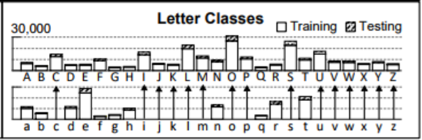
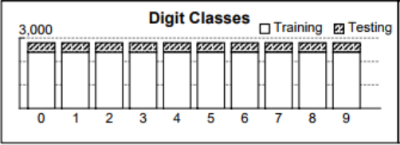
VARIOUS MODELS USED FOR THE PURPOSE
Multiclass Logistic Regression
Decision Tree
Random Forest
Neural Networks
Convolution Neural Networks
Recurrent Neural Networks
Dataset used for all the models is Extra Keras EMNIST Dataset.
Train | 112800
Test | 18800
Total | 131600
Classes | 47

Slide 9
BLOCK DIAGRAM
Raw Data
Data Processing
Processed Data
Train Model (Train Accuracy)
Test Accuracy
Model Tuning
Accuracy Satisfied?
Deploy Model

Slide 10
RESULTS
Accuracy of the various models used is tabulated below:
Model | Accuracy (%)
Multiclass / Multinomial Logistic Regression | 69.42
Decision Tree | 58.90
Random Forest | 80.92
Neural Network | Train: 91.07, Test: 83.36
Convolution Neural Network | Train: 93.51, Test: 85.07
Recurrent Neural Network | Train: 93.15, Test: 86.81

Slide 11
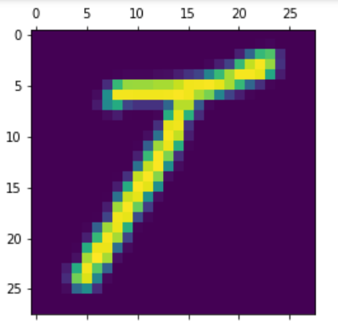
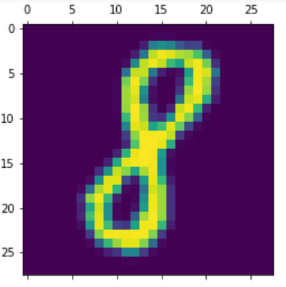
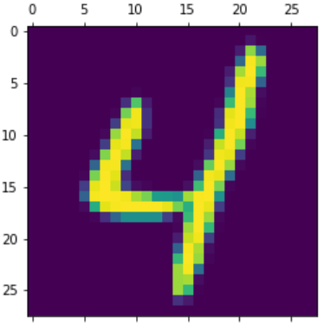
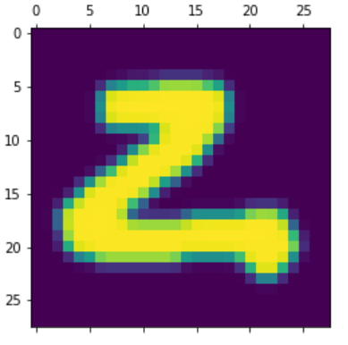
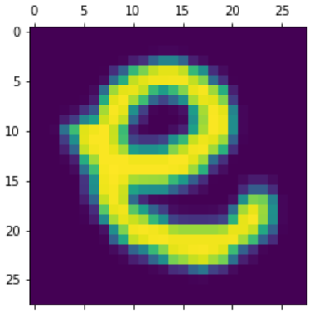
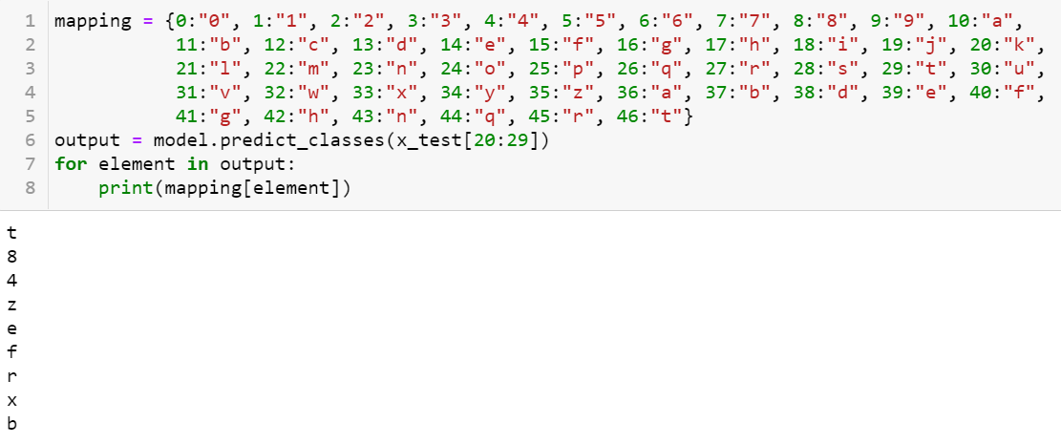

Slide 12
CONCLUSION AND FUTURE SCOPE
A suggested method for converting handwritten text to digital text has been developed and evaluated. There has been a comparison with related works shown.Various models have been trained for this purpose with various types of input datasets.
A digital text conversion technique for handwritten text has been created and tested. A comparison with related works has been displayed..
By breaking apart words and removing the letters, it can also be used to recognize and transform sentences.

Slide 13
REFERENCES
https://ieeexplore.ieee.org/document/7130278
https://www.academia.edu/49062168/Classification_of_Documents_Extracted_from_Images_with_Optical_Character_Recognition_Methods
https://ieeexplore.ieee.org/document/8663011
https://www.academia.edu/49062168/Classification_of_Documents_Extracted_from_Images_with_Optical_Character_Recognition_Methods
https://ieeexplore.ieee.org/document/9297418

Slide 14
THANK YOU

